Slide 1
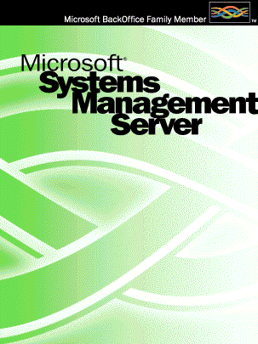
SMS
Microsoft
Systems Management Server
2.0
Presented by
Dave Robinson
Technical Architect
TUSK Technologies
Notes:
Microsoft System Management Server – as installed within DOJ.
There are 2 installations, both with different options and configuration settings.
Where possible, I will point out the differences.

Slide 2
Why ?
“All networked servers and desktops must have an active SMS client installed.”
Rod Matthews,
Manager,
Integration & Planning
17 Dec 2001
Notes:
Why Install SMS ?
The primary reason is to allow the DOJ to accurately monitor their assets. There are a number of other reasons as well, but these are directly related to the SMS feature set.

Slide 3
SMS Objective
Provide a stable, dependable platform to allow the Department of Justice to manage their computer fleet, with minimal cost to the Department.

Slide 4
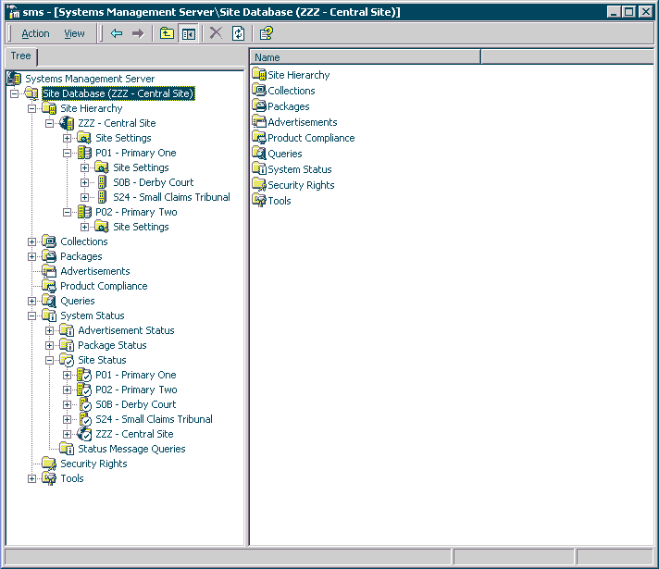
What is SMS ?
SMS is a comprehensive solution for managing networked computers. It is an administrative package that enables us to support the network more effectively and at a reduced cost.
The major features of SMS are briefly discussed in the following slides.
Notes:
This is the SMS Console. It utilizes the Microsoft Management Console, and may be installed on any Computer. By default, we use Terminal Services to work with the Installations already on the SMS Servers.

Slide 5
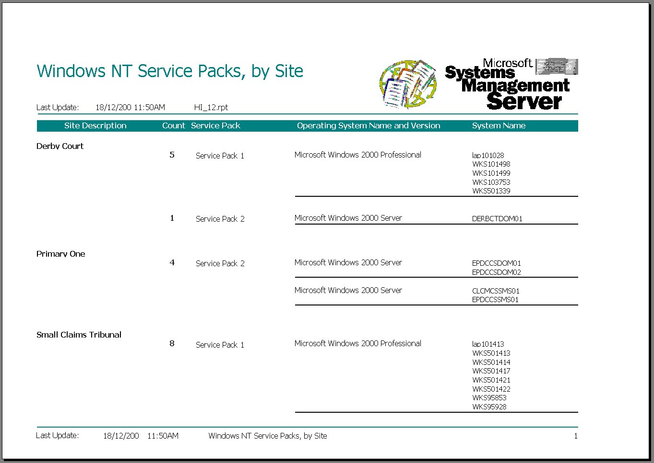
Hardware and Software Inventory
SMS automatically collects detailed configuration information about all computers on the network. For example, we will be able to gather data about how many copies of a software application are installed on computers throughout the organization, which computers need hardware upgrades, or the specific network address for a computer.
Crystal Reports
Notes:
This happens once a week, at different times so as to reduce Network traffic.

Slide 6
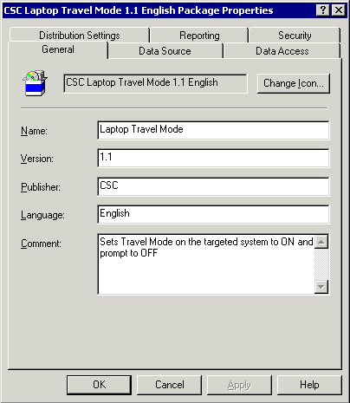
Software distribution and installation
These capabilities make it easy to electronically distribute and install applications, upgrades, or any other type of software to computers throughout the DOJ.
Notes:
By default, every client checks every 60 minutes for an Advertisement. This Advertisement contains instructions about the package, including where to download it from, and what to do with it.
It is also possible to uninstall software, especially if there was a Wise InstallMaster package used to deploy it.

Slide 7
Software License metering
This capability could allow us to verify that our software use falls within our software licensing agreements. We could also be able to use data from software metering to project our future software needs and balance software use throughout the DOJ so that user’s can access software programs when they need them.
Note: This is NOT used within the DOJ
Notes:
License Metering requires a separate Server for every Site, and is very bandwidth intensive. Basically, what happens is, every time the user runs an application, the workstation goes away to the Server and checks if the application is configured for License Metering. If not, the workstations runs the application as normal. If however, it is configured, then the Server has to determine whether the user is allowed to run it or not, based on License usage.

Slide 8
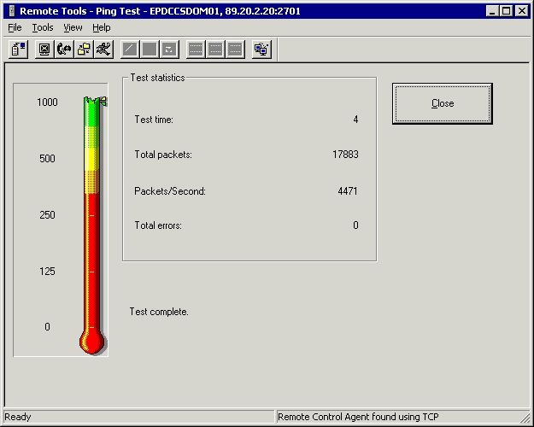
Remote Tools
This feature gives us access to critical diagnostic information about remote computers. When a user is having problems with their computer, it also allows us to remotely work on their computer across a local area network (LAN) or a wide area network (WAN) to diagnose and solve software problems. These features may improve the speed and quality of our technical support. Other features include:
Reboot, Chat, File Transfer, and Remote Run.
Notes:
As opposed to Terminal Services, Remote Control allows the user to see the Administrator perform the functions, in a similar fashion to VNC.
Differently to VNC however, is the user’s ability to disallow the Administrator from starting a Remote Control Session.
The use of Remote Control has been accepted on every Courts workstation. This permission was granted by John Klarich.

Slide 9
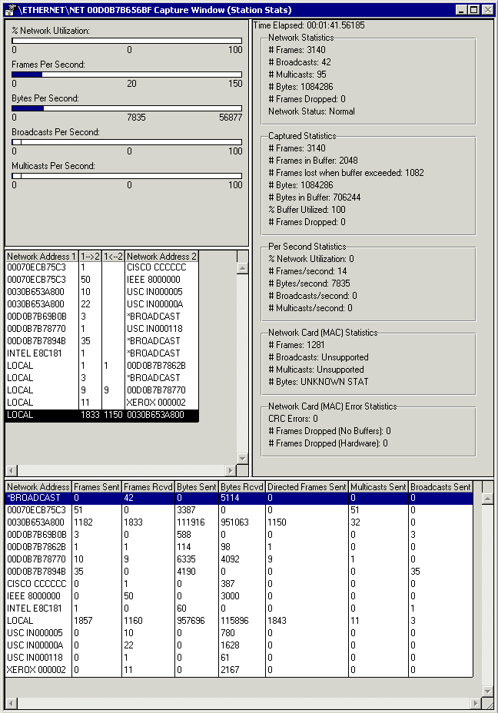
Network Analysis
This feature enables us to detect and troubleshoot network problems on LANs, WANs, or serial links. We will be able to view the details of network packets, perform remote captures on a packet anywhere on the network, and gather network statistics about a group of computers.
Notes:
This is the familiar Network Monitor application that most people know from NT 4.0. This however, is the ‘full blown’ version, and allows the Network card to operate in Promiscuous Mode, thus allowing the Administrator to view any packet from anywhere.
This version has also got what are known as ‘Experts’, which perform a number of tests on the captured traffic, thus allowing the Administrator to know for example the top 10 users on the segment.

Slide 10
SMS Functions
Who can upgrade to Windows 2000 ?
How many Pentium II’s in DOJ ?
Hardware Inventory
Do we have enough Licenses ?
Who has Quake installed ?
Software Inventory
Windows 2000 Service Pack 3
Security Hotfix for IIS
Software Distribution
Chat
Use Remote Control to add a printer
Remote Tools
Who is copying large files ?
Network Analysis
How much traffic is on that subnet ?
Software License Metering
Not used in DOJ
VERY Bandwidth Intensive
Notes:
SMS functions allow the Administrator to answer a lot of previously unanswerable questions, and other questions that were just plain hard to answer.

Slide 11
SMS Clients
Each Computer must be Discovered.
There are a number of Discovery methods, with the DOJ primarily using Network Discovery.
Once Discovered, the SMS Client Core Components are installed.
A Client may be installed using Manual Installation (smsman.exe), Remote Installation, and Logon Installation via smsls.bat. This last method is essentially a combination Discovery and Installation method.
After the Client Core Components are installed, the Client will then download and Install the Client Agents.
It is these Agents that perform the SMS Client Functions. For example, there is a Hardware Discovery Agent, as well as an Advertised Programs Agent.
Notes:
For any SMS Function, each computer that you wish to perform an operation on, that computer must be an SMS Client.
Each SMS Client works with its Parent Site in providing this Functionality.
Note that WBEM is also installed (or upgraded) as part of the SMS Client Core, if not already installed. NT4 Clients do not have WBEM installed as standard. If the Client is uninstalled, WBEM cannot be uninstalled as it becomes a part of the Operating System.
<D E M O> Show Collection of Clients within SMS Console.

Slide 12
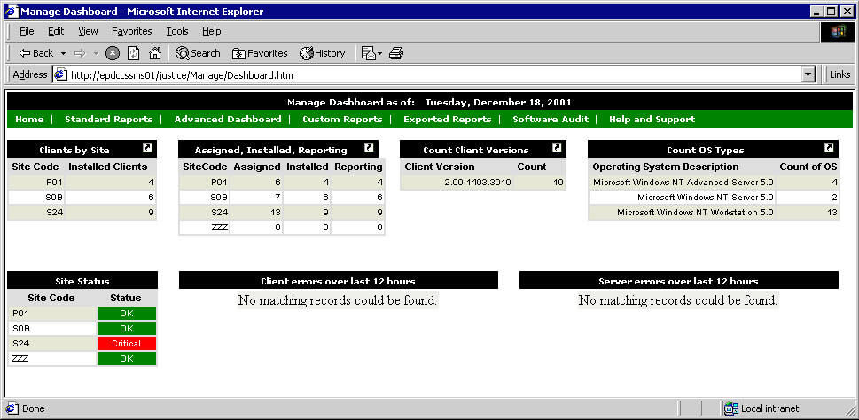
SMS Reporting
Web Reports
Crystal Reports
SMS Console
Notes:
There are 3 Reporting Methods available.
Web Reports, which is a free add-on by Microsoft,
Crystal Reports, this being a cut-down version of Crystal Reports 6, and
The SMS Console itself.
From the Console we can export lists to Comma Separated Value (csv) files, or just view the information.
The next 3 slides show these screenshots better.

Slide 13
SMS Reporting
Notes:
Crystal Reports
<D E M O>

Slide 14
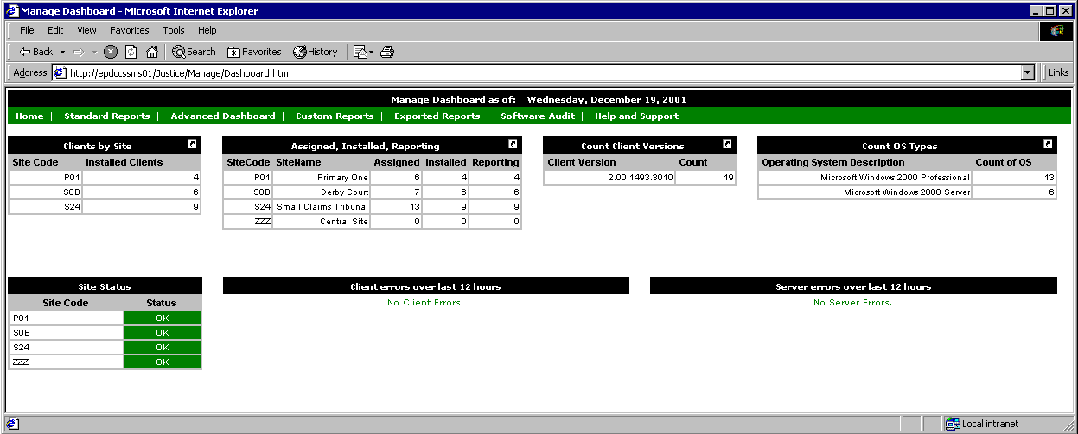
SMS Reporting
Notes:
Web Reports
<D E M O>

Slide 15
SMS Reporting
Notes:
SMS Console
<D E M O>

Slide 16


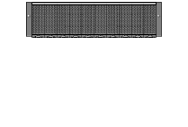
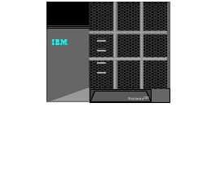
SMS Architecture
EPDCCSSMS01
Dual PIII 800, 512 Mb
2 x 18 Gb System
3 x 36 Gb Data
Central Site Server
Primary Site Servers
CLCMCSSMS01
PIII 550, 768 Mb
2 x 4 Gb System
4 x 9 Gb Data
CLCMCSSMS02
PIII 550, 768 Mb
2 x 4 Gb System
3 x 18 Gb Data
Secondary Site Servers
Courts Site
Courts Site
Courts Site
Courts Site
NOTE: Simplified Diagram
Notes:
Within SMS, there are many ‘Parent Child’ relationships. SMS is essentially a Hierarchical design, where a Child reports to its Parent.
The Central Site Server is the main repository for SMS Software Packages. It also holds the amalgamated database of all SMS Clients within the Organisation.
The Primary Site Servers perform most of the hard work for the Central Site.
The Secondary Site Servers act as temporary holding points for the Clients. All Client information flows from the Client, through the Secondaries, and up to the Primary Site Server. Once at the Primary, the client information is entered into the Database.
The SMS Servers require a very stable Hierarchy to function correctly.
This hierarchy is exactly as Microsoft Recommends.

Slide 17
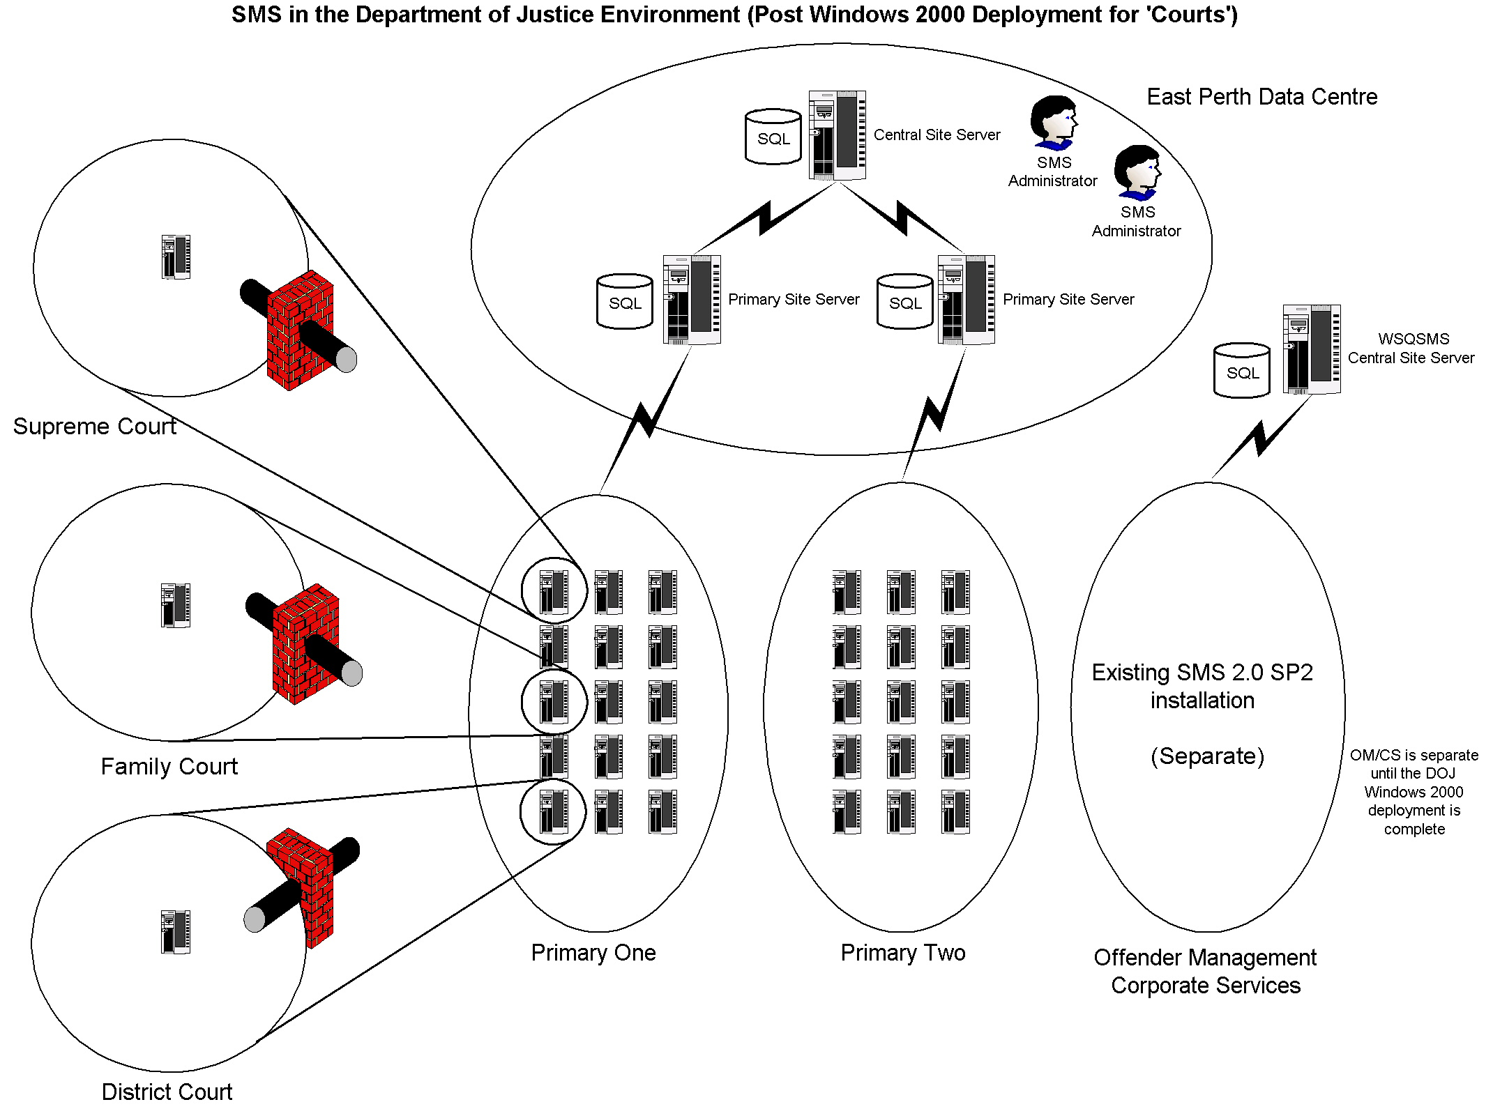
SMS Architecture
Notes:
Here is the planned SMS Structure. At the end of this Courts rollout and Installation, this is how things will look.
Note the OM / CS installation is completely separate from Courts.

Slide 18
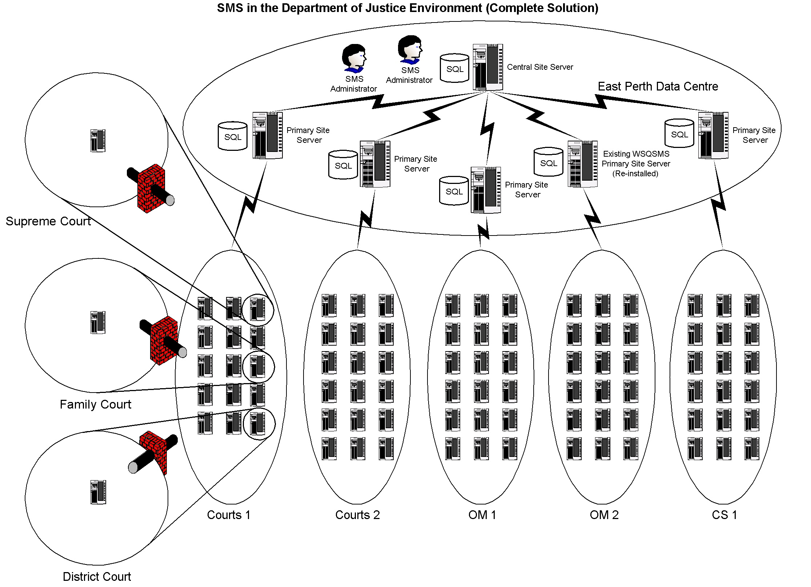
SMS Architecture
Notes:
If and when CS and OM are rolled out with Windows 2000, this is how the SMS structure will look.
Note there is now one Central Site Server, and any reporting will encompass all Clients within DOJ.

Slide 19
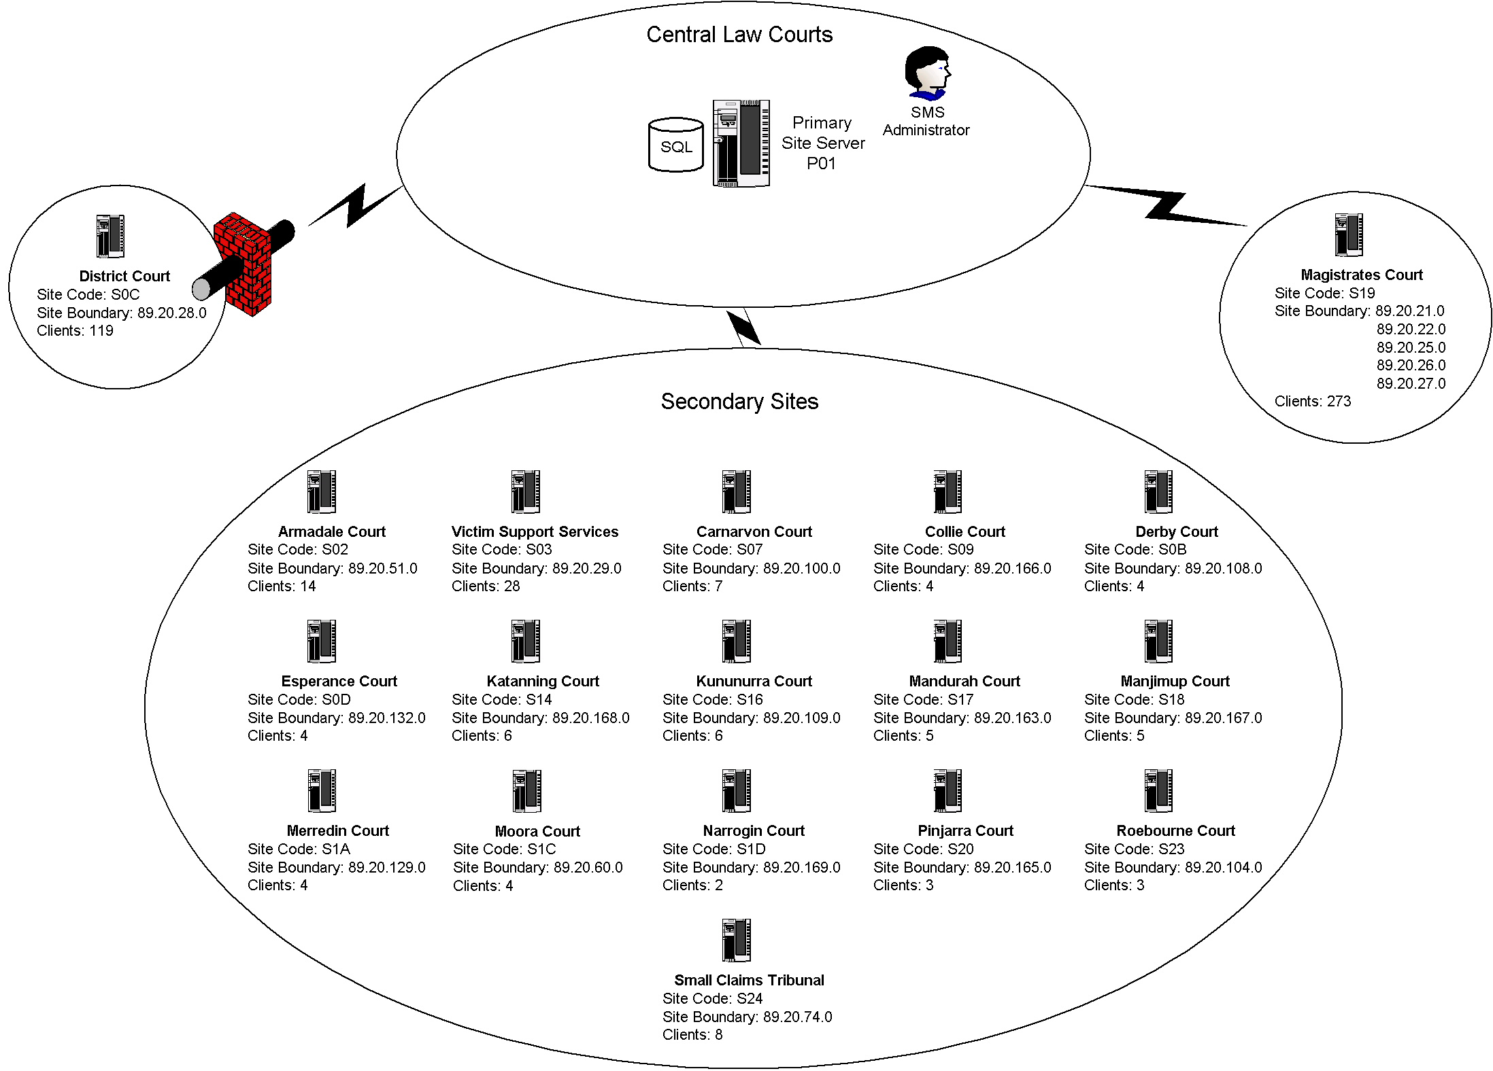
SMS Architecture
Notes:
This is the Primary One Hierarchy.
Primary One is the SMS Primary Site Server CLCMCSSMS01 located at Central Law Courts.

Slide 20
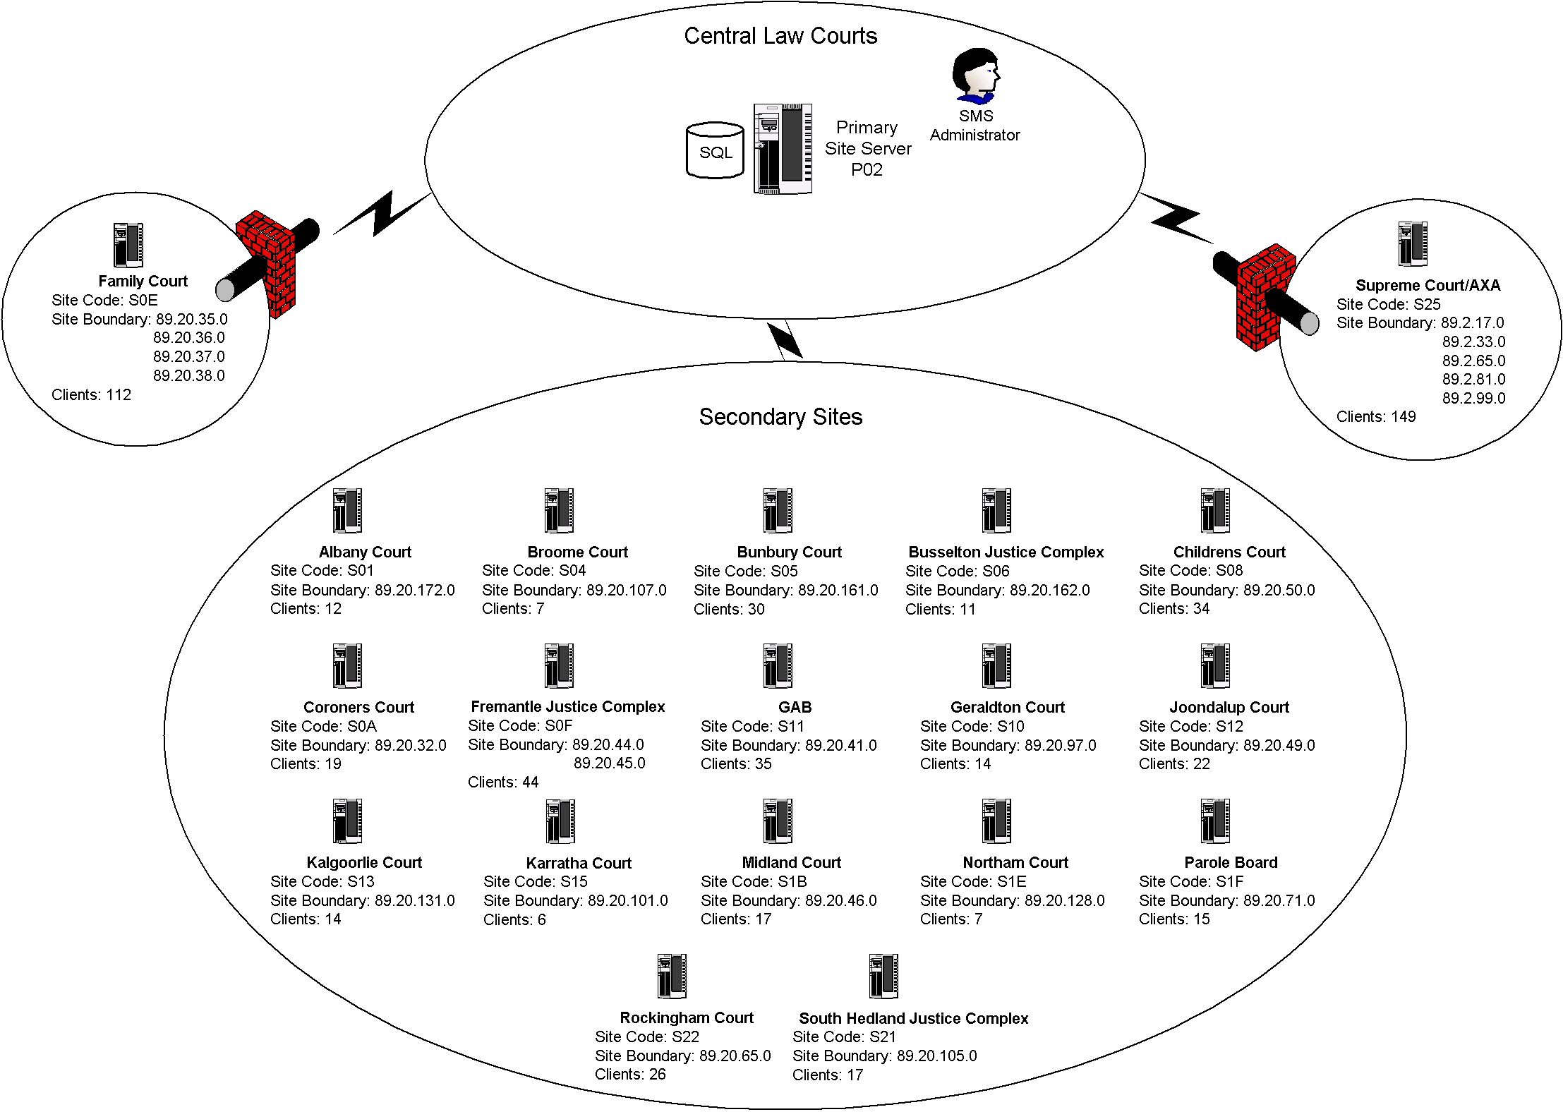
SMS Architecture
Notes:
This is the Primary Two Hierarchy.
Primary Two is the SMS Primary Site Server CLCMCSSMS02 also located at Central Law Courts.

Slide 21
Questions
Notes:
Mention Site Systems and how they are installed – including Bandwidth utilisation.
Mention Collections <D E M O>
Mention SMS_DEF.MOF file and how it affects HW Inventory.

